Slide 1
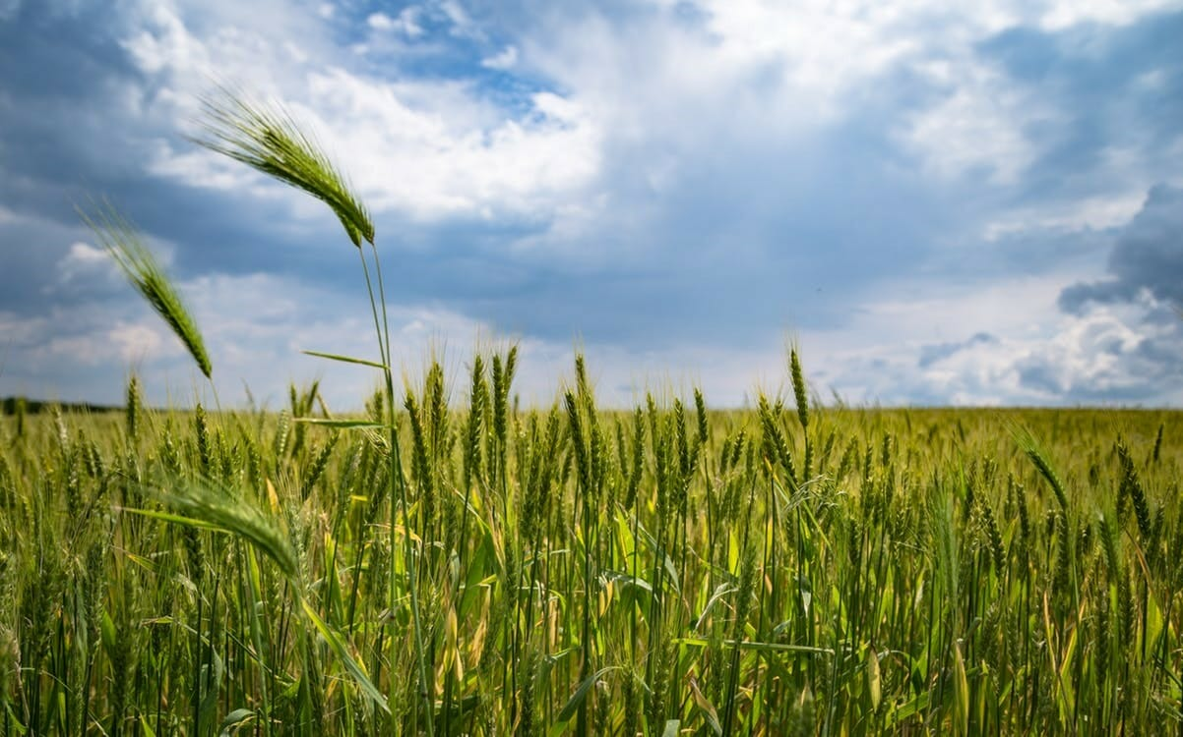
Agri-Go
Revolutionizing Agriculture with Machine Learning
Akanksha tiwari
Abhishree Bisht
Navya Rajvanshi
Mudita

Slide 2
Introduction to Agri-Go
Agri-Go is a machine learning model designed to revolutionize agriculture by identifying crop diseases, pest infestations, and nutrient deficiencies in plants.
The goal of Agri-Go is to provide farmers with a powerful tool to monitor and manage the health of their crops, leading to increased yields and reduced losses.
By leveraging machine learning algorithms, Agri-Go can analyze images of plants and accurately detect and classify various issues that can affect crop health.
This enables farmers to take timely and targeted actions to prevent the spread of diseases, control pest infestations, and address nutrient deficiencies.

Slide 3
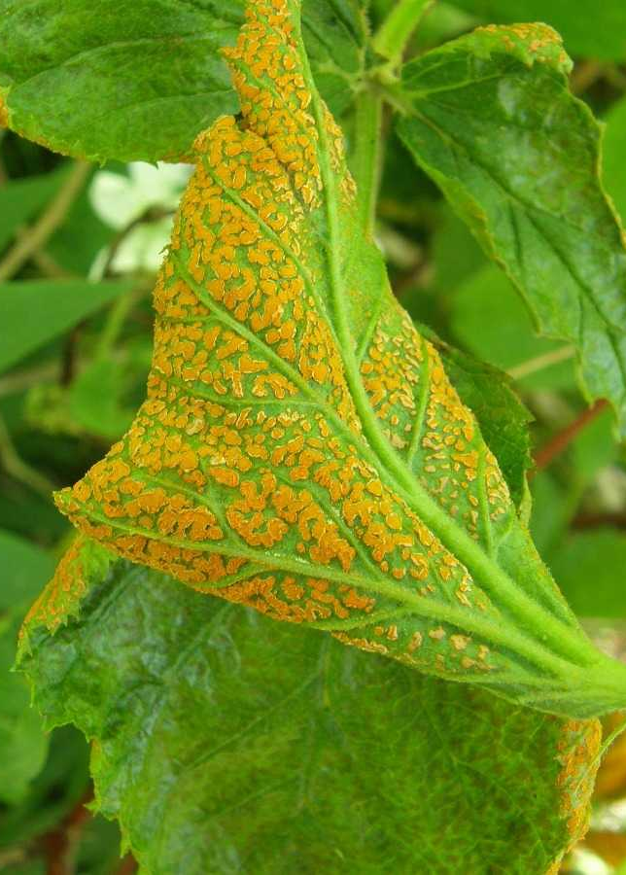
Crop Disease and Pest Identification
By analyzing images of plants, Agri-Go can accurately identify the specific disease or pest affecting the crop, allowing farmers to take timely actions.
Farmers can capture images of their crops using a smartphone or a dedicated camera and upload them to the Agri-Go platform. The model will then analyze the images and provide a detailed report on the identified disease or pest, along with recommended treatment options.

Slide 4
Crop Recommendation Based on Soil Analysis
Agri-Go utilizes advanced machine learning algorithms to recommend the best crops based on soil analysis. By analyzing the composition and nutrient levels of the soil, Agri-Go can provide valuable insights into the suitability of different crops for a specific area.
The process begins with soil sampling, where samples are collected from various locations in the field. These samples are then analyzed in a laboratory to determine the nutrient levels, pH balance, and other important factors.
The model takes into account factors such as optimal pH levels, nutrient requirements, and water availability.
Based on this analysis, Agri-Go generates a list of recommended crops that are most likely to thrive in the given soil conditions.

Slide 5
Fertilizer Prediction and Nutrient Deficiency Detection
By analyzing various factors such as soil composition, weather conditions, and plant characteristics, Agri-Go can accurately predict the best fertilizers for optimal plant growth and detect nutrient deficiencies early on.
By considering factors such as nutrient levels, pH balance, and moisture content, the model can recommend the most suitable fertilizers for specific crops and soil conditions.
Agri-Go can also detect nutrient deficiencies in plants by analyzing visual symptoms and leaf characteristics.
By comparing the observed symptoms with a comprehensive database of plant diseases and nutrient deficiencies, the model can accurately identify the specific nutrient lacking in the plant.

Slide 6
Conclusion
Key Points Discussed
Agri-Go is a machine learning model that identifies crop diseases, pest infestations, and nutrient deficiencies in plants.
It uses image recognition technology to analyze plant images and provide accurate and timely diagnoses.
Agri-Go has the potential to revolutionize the agricultural industry by enabling farmers to quickly identify and address plant health issues.

Slide 7
Future Plans
Further refine and improve the accuracy of the Agri-Go model by training it on a larger dataset.
Expand the range of crops and plant diseases that Agri-Go can identify.
Develop a user-friendly mobile application that allows farmers to easily capture and submit plant images for analysis.
Collaborate with agricultural experts and organizations to promote the adoption of Agri-Go in farming communities.

Slide 8
THANK YOU !

